Slide 1
Route 53

Slide 2
What Is Amazon Route 53?
Register domain names
Route internet traffic to the resources for your domain
Check the health of your resources

Slide 3
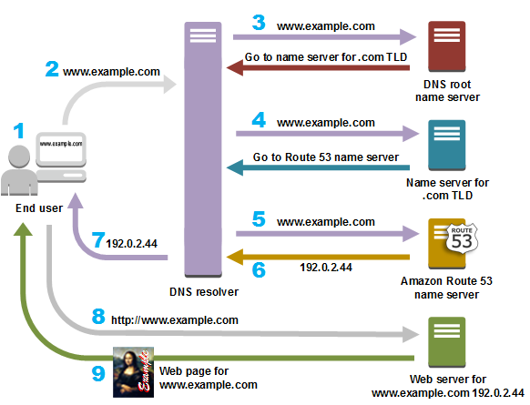
Amazon Route 53 Routes Traffic for Your Domain

Slide 4
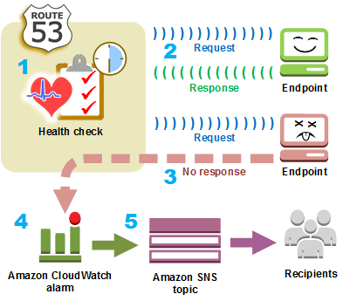
Amazon Route 53 Checks the Health
request interval
failure threshold

Slide 5
Integration with Other Services
Logging, Monitoring, and Tagging
AWS CloudTrail
Amazon CloudWatch
Routing Traffic to Other AWS Resources
Amazon CloudFront
Amazon EC2
AWS Elastic Beanstalk
Elastic Load Balancing
Amazon RDS
Amazon S3

